Slide 1

PRESENTATION
Role of Physics in
Computer Science and
Engineering
How the laws of physics quietly power every chip, signal, and system in modern computing.
Department of Computer Science and Engineering • World University Of Bangladesh • Batch 73A
PRESENTED BY
Sakhawat Hossain Samir
Sahariar Nayme
Aritra Tarafder
Presenter 4 Name
Roll No: 5226
Roll No: 5246
Roll No: 5225
Roll No: [XXXXXXX]
Notes:
Welcome the audience and introduce the presentation title and team. Briefly explain that this talk explores how physics underlies computer science and engineering, from hardware to emerging technologies. Introduce each of the four presenters by name.

Slide 2







FOUNDATIONS
Why Physics Matters in CSE
Every computation task happens inside a physical device that follows
the law of Physics.
FROM LAW TO LOGIC
Computers Are Physical Systems
Every processor, memory cell, and wire is a physical object obeying the laws of nature.
Physical Law
Electricity & Signals Power Devices
Digital technology runs on the controlled flow of electrons and voltage signals.
Electric Signal
Physics Underpins Hardware & Communication
From transistors to transmission lines, physics is the foundation everything is built on.
Digital Logic
PHYSICS IN CSE
02
Notes:
Explain that computers are not abstract mathematical objects but physical machines. Electricity and signals are what actually carry information, and physics gives us the rules that make hardware and communication possible. This slide sets up the rest of the presentation.

Slide 3
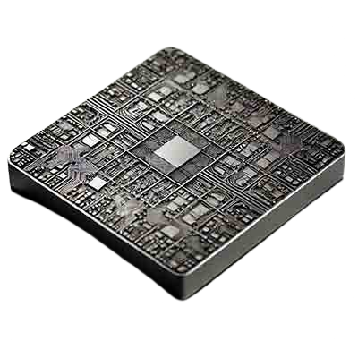



HARDWARE
Physics in Computer Hardware
INSIDE THE PROCESSOR
Semiconductor Physics Enables Transistors
Quantum behavior of electrons in silicon lets transistors switch on and off reliably.
CPUs & GPUs Depend on Circuits
Processing power comes from electronic circuits built on electromagnetic principles.
Silicon Die
Thermodynamics Manages Heat & Power
Millions of transistors switch billions of times per second inside a space smaller than a fingernail.
Cooling systems and power efficiency rely directly on the laws of thermodynamics.
PHYSICS IN CSE
03
Notes:
Walk through how semiconductor physics makes transistors possible, how CPUs and GPUs are built from electronic circuits, and why thermodynamics matters for cooling and power efficiency in modern hardware. Point to the chip diagram to make the silicon die tangible.

Slide 4



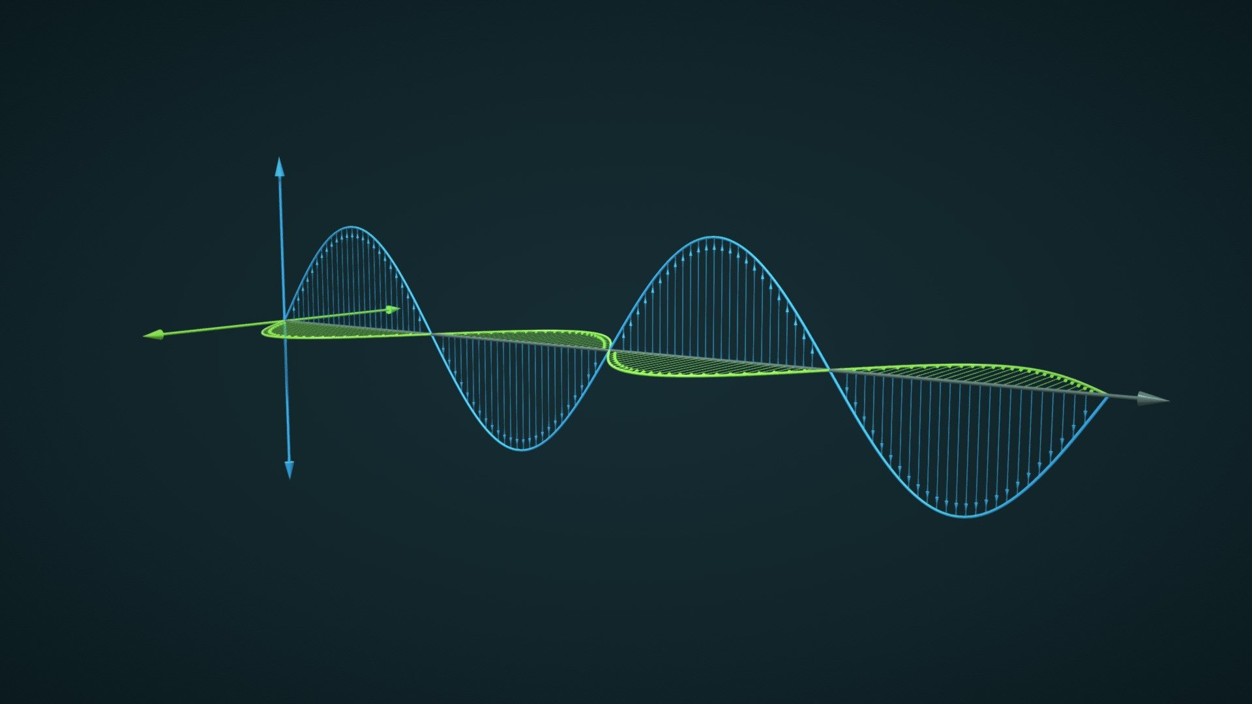

NETWORKING
Physics in Networking & Communication
Every message that travels across a network rides on a physical carrier: waves, light, or electrical pulses.
Electromagnetic Waves
Fiber Optics & Light
Signal Processing
Wireless communication travels through space as oscillating electric and magnetic fields.
Data is transmitted as pulses of light guided through thin strands of glass fiber.
Encoding, filtering, and decoding signals all depend on fundamental physical laws.
Transmitter
EM Wave
Fiber Link
Receiver
PHYSICS IN CSE
04
Notes:
Explain that wireless communication relies on electromagnetic waves propagating through space, fiber optics uses total internal reflection of light to move data at high speed, and signal processing techniques are built on physical and mathematical laws that filter and decode information.

Slide 5




GRAPHICS & SIMULATION
Physics in Graphics & Simulation
SIMULATED TRAJECTORY
Physics Engines Simulate Motion
Collision, gravity, and momentum are calculated in real time to drive interaction.
Optics Creates Realistic Rendering
Light reflection, refraction, and shadow models make rendered scenes believable.
Used in Gaming, VR & Simulation
From game engines to flight simulators, physics makes virtual worlds feel real.
Physics governs every bounce, beam, and shadow rendered on screen.
PHYSICS IN CSE
05
Notes:
Describe how physics engines calculate motion, collisions, and interaction forces in real time, how optics principles create realistic lighting and shadows, and how these techniques come together in gaming, virtual reality, and scientific simulation.

Slide 6



LOOKING AHEAD
Emerging Technologies
The next generation of computing leans even more heavily on advanced physics.
Uses superposition and entanglement from quantum physics to process information in fundamentally new ways.
Engineering at the atomic scale improves density, speed, and efficiency of computing devices.
Using light instead of electricity promises the next leap in high-speed computing.
Quantum Computing
Nanotechnology
Photonics
PHYSICS IN CSE
06
Notes:
Introduce quantum computing as a technology that harnesses superposition and entanglement, nanotechnology as atomic-scale engineering that improves device performance, and photonics as a light-based approach to future high-speed computing. Emphasize these all extend classical physics principles.

Slide 7
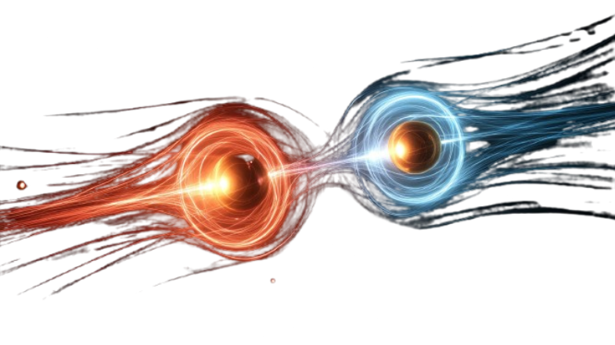



CONCLUSION
Physics Is the Foundation
of Computer Science
From the transistors in a chip to the light in a fiber-optic cable, physics is not background theory — it is the working foundation CSE is built on.
A Fundamental Part of CSE
Connects Hardware, Software & the Future
Enables Better Engineering
Physics is not optional background — it is core to how computing works.
It links circuits, networks, graphics, and next-generation technologies.
Understanding physics helps engineers design faster, smarter systems.
PHYSICS IN CSE
07
Notes:
Summarize that physics underlies every layer of computer science and engineering, from hardware to networking, graphics, and emerging technology. Reinforce that a strong grasp of physics helps engineers build faster, more efficient, and more innovative systems. Thank the audience and invite questions.

Slide 8

Thank You
Any Question ?
Notes:
Summarize that physics underlies every layer of computer science and engineering, from hardware to networking, graphics, and emerging technology. Reinforce that a strong grasp of physics helps engineers build faster, more efficient, and more innovative systems. Thank the audience and invite questions.

